Slide 1
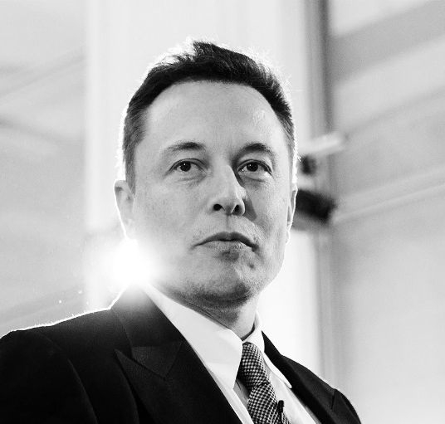
learned programming
ELON
founded Zip2
HOW
MUSK
founded Paypal
STARTED
founded SpaceX
founded Tesla

Slide 2
learned programming
ELON
founded Zip2
HOW
MUSK
founded Paypal
STARTED
founded SpaceX
founded Tesla

Slide 3






learns BASIC in 3 days instead of 6 months
creates video game, sells it for $500
sells Zip2 for
$20 million
raises first investment money ($3 million)
starts Zip2, codes program himself
starts X.com which later becomes PayPal
merges with competitor, Paypal is born
Paypal sold to Ebay
for $1.5 Billion

Slide 4



STARTS

Slide 5
STARTS

Slide 6

