Slide 1
Topic 6 Business model canvas
Key Activities
Key Partners
Value Proposition
Customer Relationships
Customer Segments
8
7
2
4
1
Key Resources
Channels
6
3
Cost Structure
Revenue Streams
9
5
EFFICIENCY
VALUE

Slide 2
Topic 6 Business model canvas
Key Activities
Key Partners
Value Proposition
Customer Relationships
Customer Segments
The most important things your company must do to make its business model work:
Production - Tesla
Problem-solving - Consultancy Platform / Network – Uber, Amazon
Whom you partner with to make your business work.
Suppliers, strategic alliances, joint ventures, buyers, acquisitions.
The product/services that create value for your customer segments and the reasons why these customers would turn to your company over another.
a)Newness - Mobile
b)Performance -PC c)Customization – eCommerce
d) Design / Brand - Fashion
e) Price, Convenience
How to acquire and build relationships with customers.
Transactional (Kiosk Check-in), Long-term(Hospital)
Self-service (SaaS)
The different groups of people your company aims to reach and serve:
a)Mass market: Coca-Cola) b) Niche: Hims and hers
c) Segmented: City Bank
d) Diversified: Amazon
Key Resources
Channels
The assets required to make your business work.
Physical - Walmart
Intellectual - Qualcomm Human - Tesla Financial - Netflix
How to communicate and reach your customers
a) Direct: Website, Store
b) Indirect: Wholesale, agent etc.
Cost Structure
Revenue Streams
The cash is generated from each customer segment. For instance:
Asset sale -Used car Platform
Usage fee – telecom or cloud
Subscription fee – Netflix
Brokerage fee – Stock broker
All the costs incurred to operate your business
Cost-driven – Lower cost (Southwest airline)
Value-Driven - Luxury hôtels
Fixed cost – Real estate Variable cost – Service companies
EFFICIENCY
VALUE

Slide 3
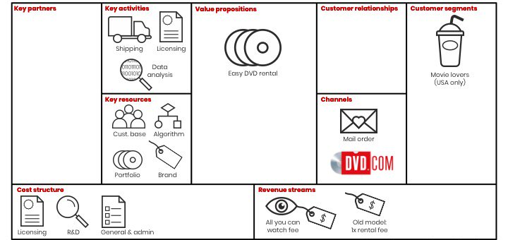
Netflix Business model canvas

